Slide 1
Human Resource Planning
Human Resource Planning (HRP) is the process of forecasting an organization’s future human resource needs and determining how the existing human resource capacity can be utilized to meet those needs effectively.
It is about making sure the right number of people, with the right skills, are in the right jobs at the right time.

Slide 2
Definition
“Human Resource Planning is the process of anticipating and making provision for the movement of people into, within, and out of an organization”. William B. Werther & Keith Davis (1996)
“Human Resource Planning is the process by which an organization ensures that it has the right number and kinds of people, at the right places, at the right time, capable of effectively and efficiently completing those tasks that will help the organization achieve its overall objectives”. Decenzo & Robbins (2002)

Slide 3
Definition
“Coleman defined Human Resources Planning as “the process of determining manpower requirements and the means for meeting those requirements in order to carry out the integrated plan of the organization”.
E.W. Vetter defines HR Planning as “A process by which an organization should move from its current manpower position to the desired manpower position. Through planning the management strives to have the right number, right kind of people at the right place and at right time, doing things which results in both organization and individual receiving maximum long run benefits.”

Slide 4
Importance of Human Resource Planning
Increasing productivity
Implementing managerial activities
Motivating employees
Coping with change
Evaluating demand and supply of resources
Increasing quality of hire

Slide 5
Human Resource Planning Process
Now a comparison is done between supply and demand. There are three possibilities. First one is supply is equal to demand, then there is no action required. Second option is surplus of workers, which means that supply is greater than demand. The possible actions include restricting hiring, reduce hours of working, downsizing, early retirement, and lay off. The third possibility is shortage of workers, which means that there is more demand than supply. The actions available for this are recruitment and training.

Slide 6
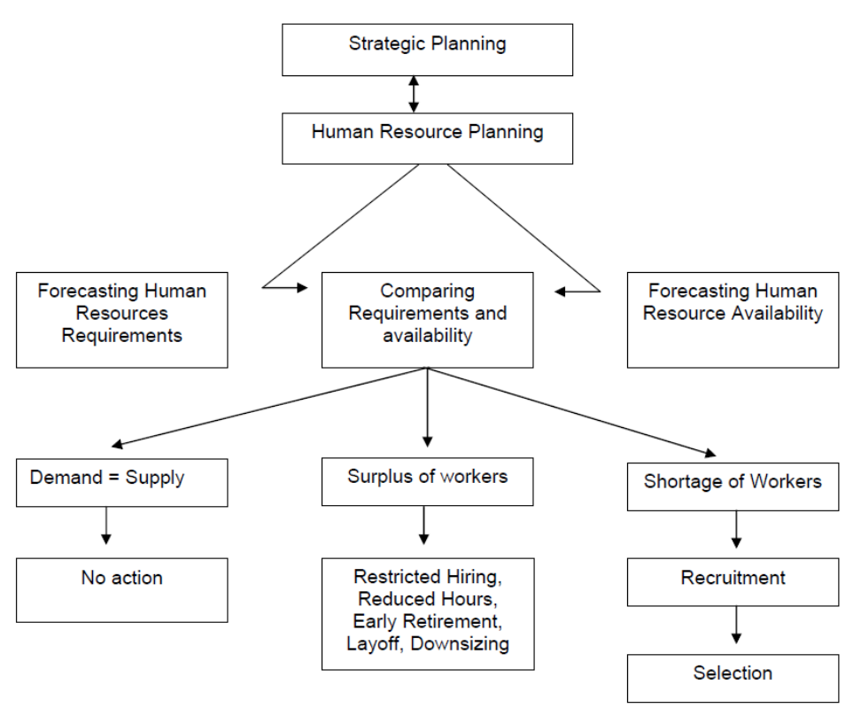

Slide 7
Various steps involved in HRP process
Determine the objectives of Human Resource Planning
Analyzing the current human resource inventory
Demand Forecasting
Trend Analysis
Computerised Forecast
Work study technique
4. Action Plan
5. Training and Development

Slide 8
Benefits of Human Resource Planning
A Better View to the business decision
Retaining top talents
Addressing the organization’s manpower needs
Facilitating expansion programs
Training employees
Managing employees

Slide 9
Factors Affecting Human Resource Planning
Type and Strategy of an Organization
Organizational Growth Cycle and Planning
Environmental Uncertainties
Time Horizon
Nature of Job Being Filled
Outsourcing

Slide 10
Barriers to HR Planning
Accuracy of Forecasts
Lack of Support of the Top Management
Resistance from Employees
Insufficient Initial Efforts
Inadequate Management Information System
Uncertainties
Expensive and Time Consuming
Unbalanced Approach

Slide 11
Tools for Demand Forecasting
Managerial Judgement
Ratio Analysis
Trend Analysis
Computerized Forecast
Work-Study Techniques
Delphi Technique

Slide 12
Challenges for HR
Retaining Top Talent
Attracting Top Talent
Building Leaders from within the Company
Creating a Healthy company culture
Measuring HR effectiveness
Encouraging effective Learning

Slide 13
Job Analysis
Job analysis is the process of gathering information about a job. It is, to be more specific, a systematic investigation of the tasks, duties and responsibilities necessary to do a job.
Job Tasks
Job Analysis
Job Duties
Job Responsibilities

Slide 14
Job analysis involves the various steps in collecting all the required and relevant information about a job. A person who carry out the job analysis is known as a job analyst.
Edwin B. Flippo “Job analysis is the process of studying and collecting information relating to the operations and responsibilities of a specific job”.
Armstrong (2010) summarizes it as a process of “clarifying what job holders are expected to do”.

Slide 15
Job analysis includes two main Components
Job Description
Job Title
Job Location
Job Summary
Reporting To
Working Conditions
Job Duties
Machines to be Used
Job Specification
Qualification
Experiences
Training
Skills
Responsibilities

Slide 16
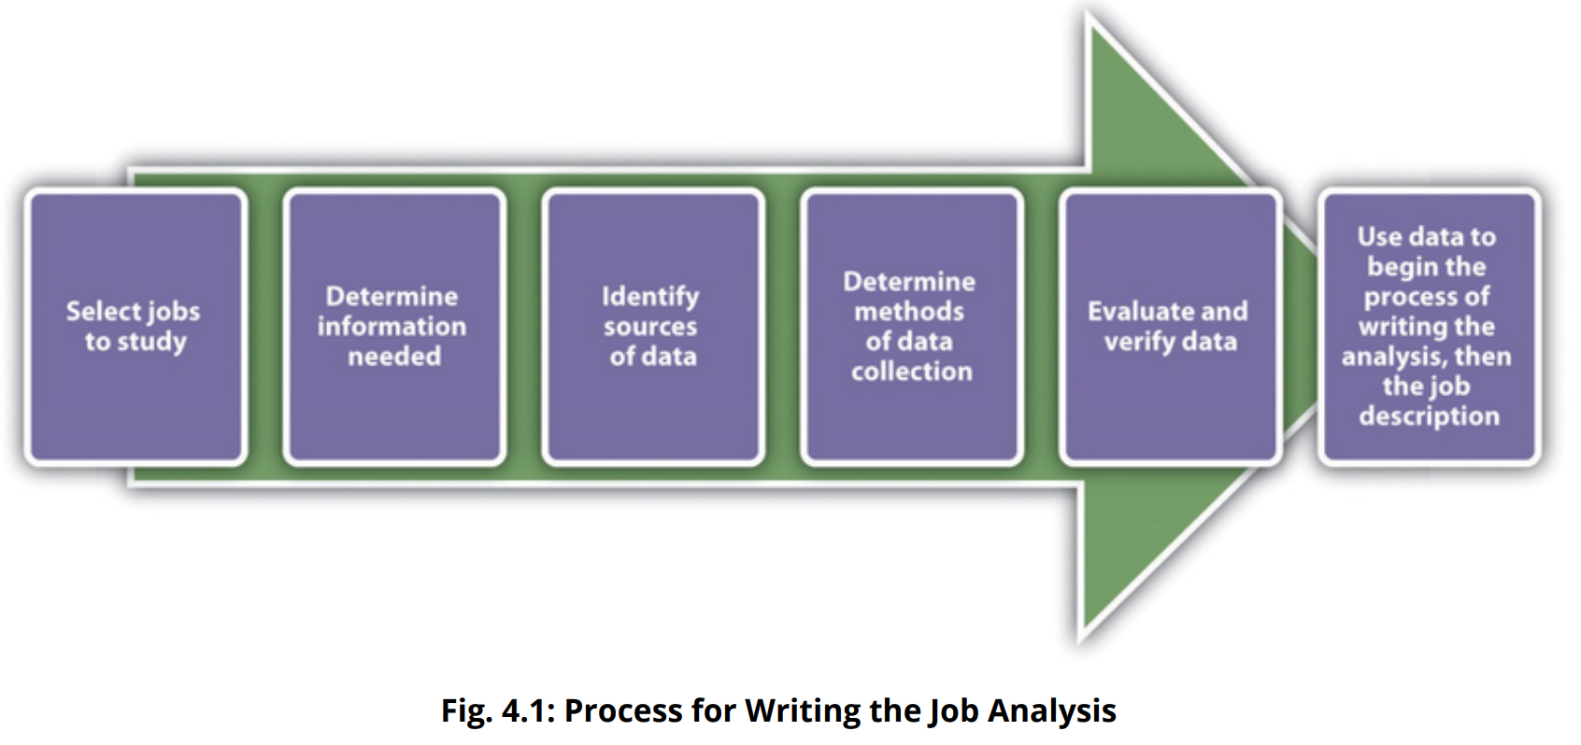

Slide 17
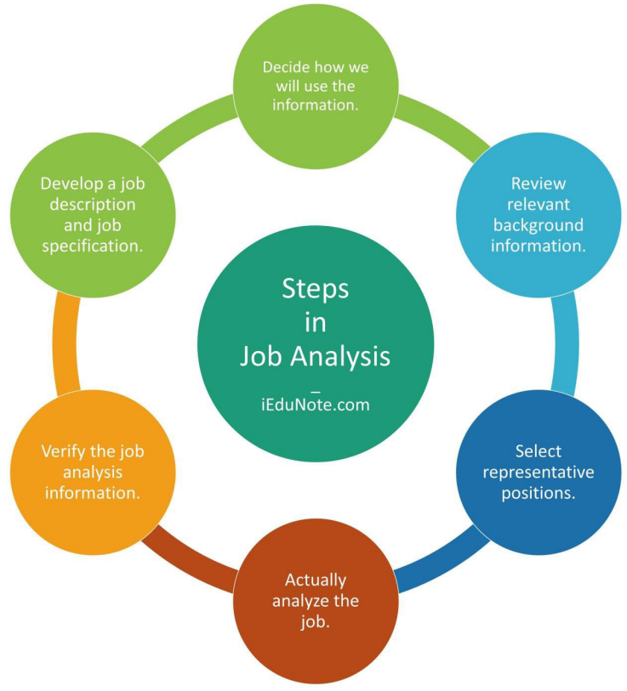

Slide 18
Job Evaluation
The purpose of job evaluation is to find the relative worth of a job and determine what a fair wage for such a job should be
“Job evaluation is a systematic and orderly process of determining the worth of a job in relation to other jobs”. Edwin B. Flippo 1984

Slide 19
Process Of Job Evaluation
Gaining acceptance from employees and trade unions
Creating a job evaluation committee
Finding the jobs to be evaluated
Analyzing and preparing job descriptions
Selecting the method of job evaluation
Classifying jobs
Installing the Programme
Reviewing the process periodically

Slide 20
Methods of Job Evaluation
Job Ranking
Job Classification
Point Factor
Factor Comparison

Slide 21

Job Ranking
The job ranking method arranges jobs in numerical order on the basis of the importance of the job's duties and responsibilities to the organization. This method, though easy to understand, is highly subjective in nature.
i. Manager
ii. Team Leader
iii. Staff Member

Slide 22
Job Classification
The job classification method slots jobs into preestablished grades. Higher-rated grades demand more responsibilities, tougher working conditions and varied job duties. This method is easy to understand and takes care of all relevant factors affecting the performance of a job. However, it is not easy to write all inclusive descriptions of a grade. Further, the method oversimplifies sharp differences between different jobs and different grades.
• Class A: Executive roles
• Class B: Professional roles
• Class C: Administrative roles

Slide 23
Point Factor
The point system of job evaluation uses a point scheme based on the compensable job factors of skill, effort, responsibility and working conditions. The more compensable factors a job possesses, the more points are assigned to it. Jobs with higher accumulated points are considered more valuable to the organization.
A job might be evaluated on five factors: Skill (0-100 points), Responsibility (0-100 points), Effort (0-100 points), Working Conditions (0-100 points), and Experience (0-100 points).

Slide 24
Factor Comparison
In this method, jobs are ranked according to a series of factors such as mental effort, physical effort, skill needed, responsibility, supervisory responsibility, working conditions, etc. pay will be assigned in this method by comparing the weights of the factors required for each job.

Slide 25
Factor Comparison

